Slide 1
QiCYCLE Company Brief
2016.11.20

Slide 2
、
2015年8月
Gained A round of investment, about 2 hundred million
Xiaomi ECO Chain Company
Global Traveling and Excising Technology Innovation company

Slide 3
QiCYCLE Team
Passion for Cycling
Internet Genes & Technology Innovation
Deep Understanding of Chinese Market

Slide 4
Competitiveness
Senior Personnel
Supplier Chain
Develop
Product
More than 10 years experienced senior personnel lead the team develop rapidly.
Software team has been led APPS what’s million level and has the ability to analyze data.
Bicycle hardware team senior personnel are from Top bicycle company.(PON、TREK、DAHON)
Strategic partnership with global E-bike core technology company.(Motors & Battery system)

Slide 5
Manufacturing supply chain concordance
Shenzhen Stock Exchange listed enterprise Xiaomi ECO Chain Company
main supplier
Support multiple product develop and Manufacture
Strategic partnership with the best supplier
The Capacity can cover worldwide and consumers’ needs
Annual Capacity more than 5milion sets assembling factory
The Best Bicycle Transmission Brand
The Best Sports Equipment Carbon Factory
Tesla Electro kinetic Cell Supplier
Annual Capacity more than 5milion sets assembling factory

Slide 6
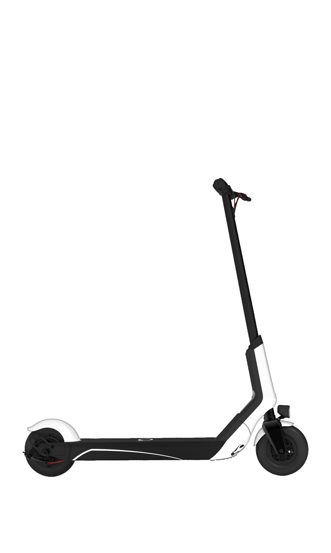
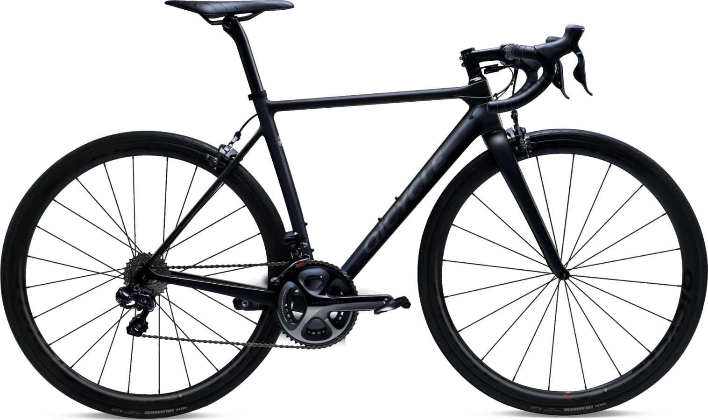
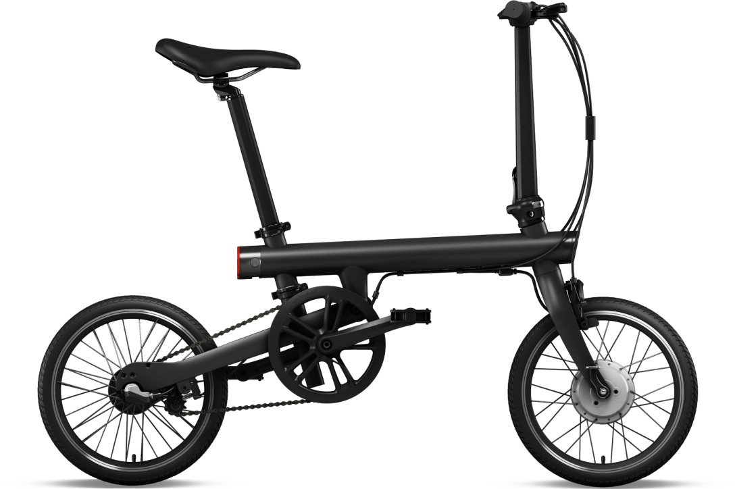
2016 Product（China）
Mijia QiCYCLE
Smart Folding Pedelec
R1 TOUR Level Road Bike
EUNI E-Scooter
Launched in 2016.08.16
Retailer Price in China￥2,999
Sales amount more than 50 million RMB
Launched on 2016.4.23
￥19,999 ($3000) in China
More than $ 15 million sold
Launched on 2016.10.08
￥1,999 ($300) in China
More than $ 3 million sold

Slide 7
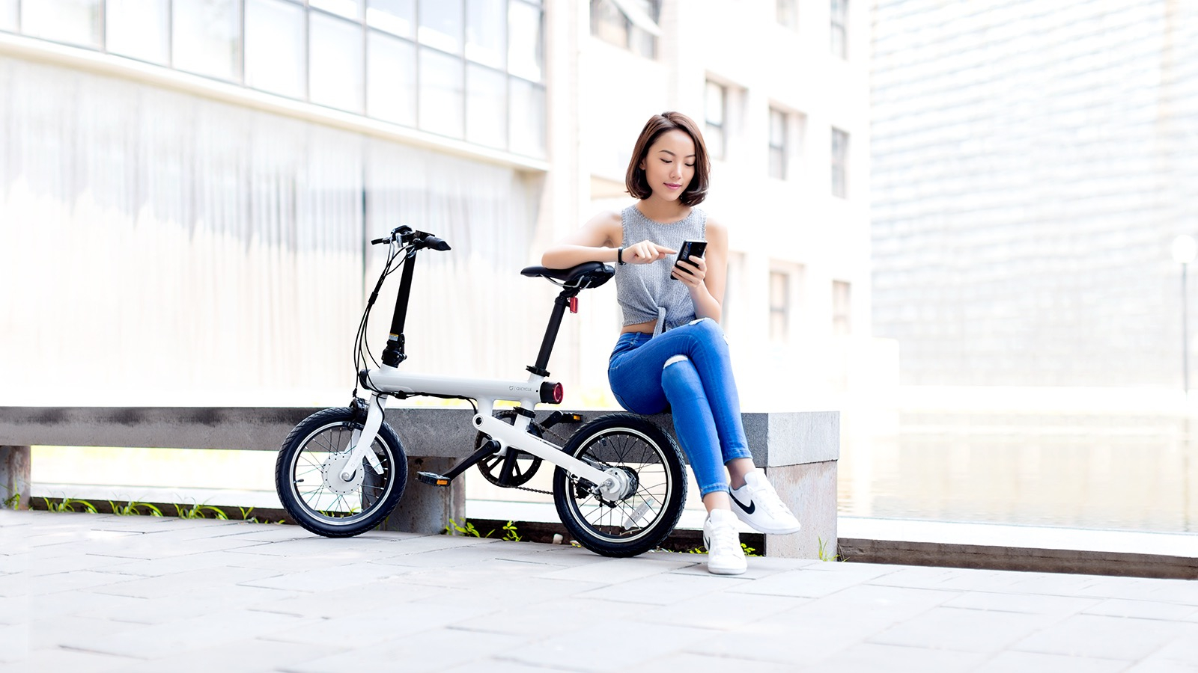
Beauty of technology
achieve fun cycling

Slide 8
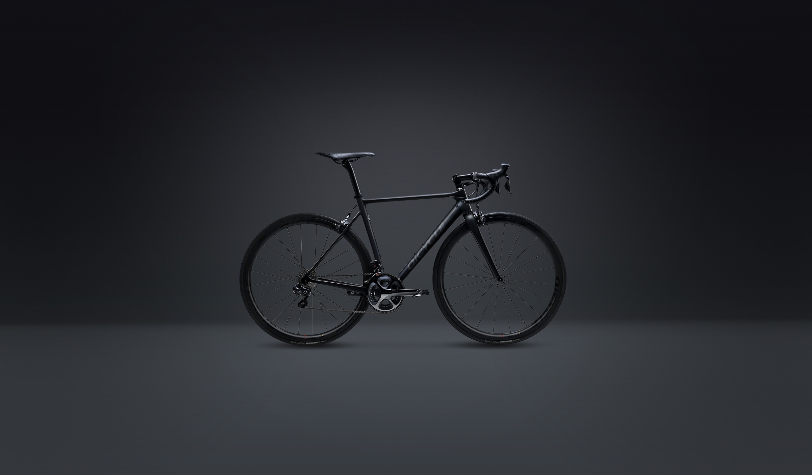
R1 TOUR Level Road Bike

Slide 9
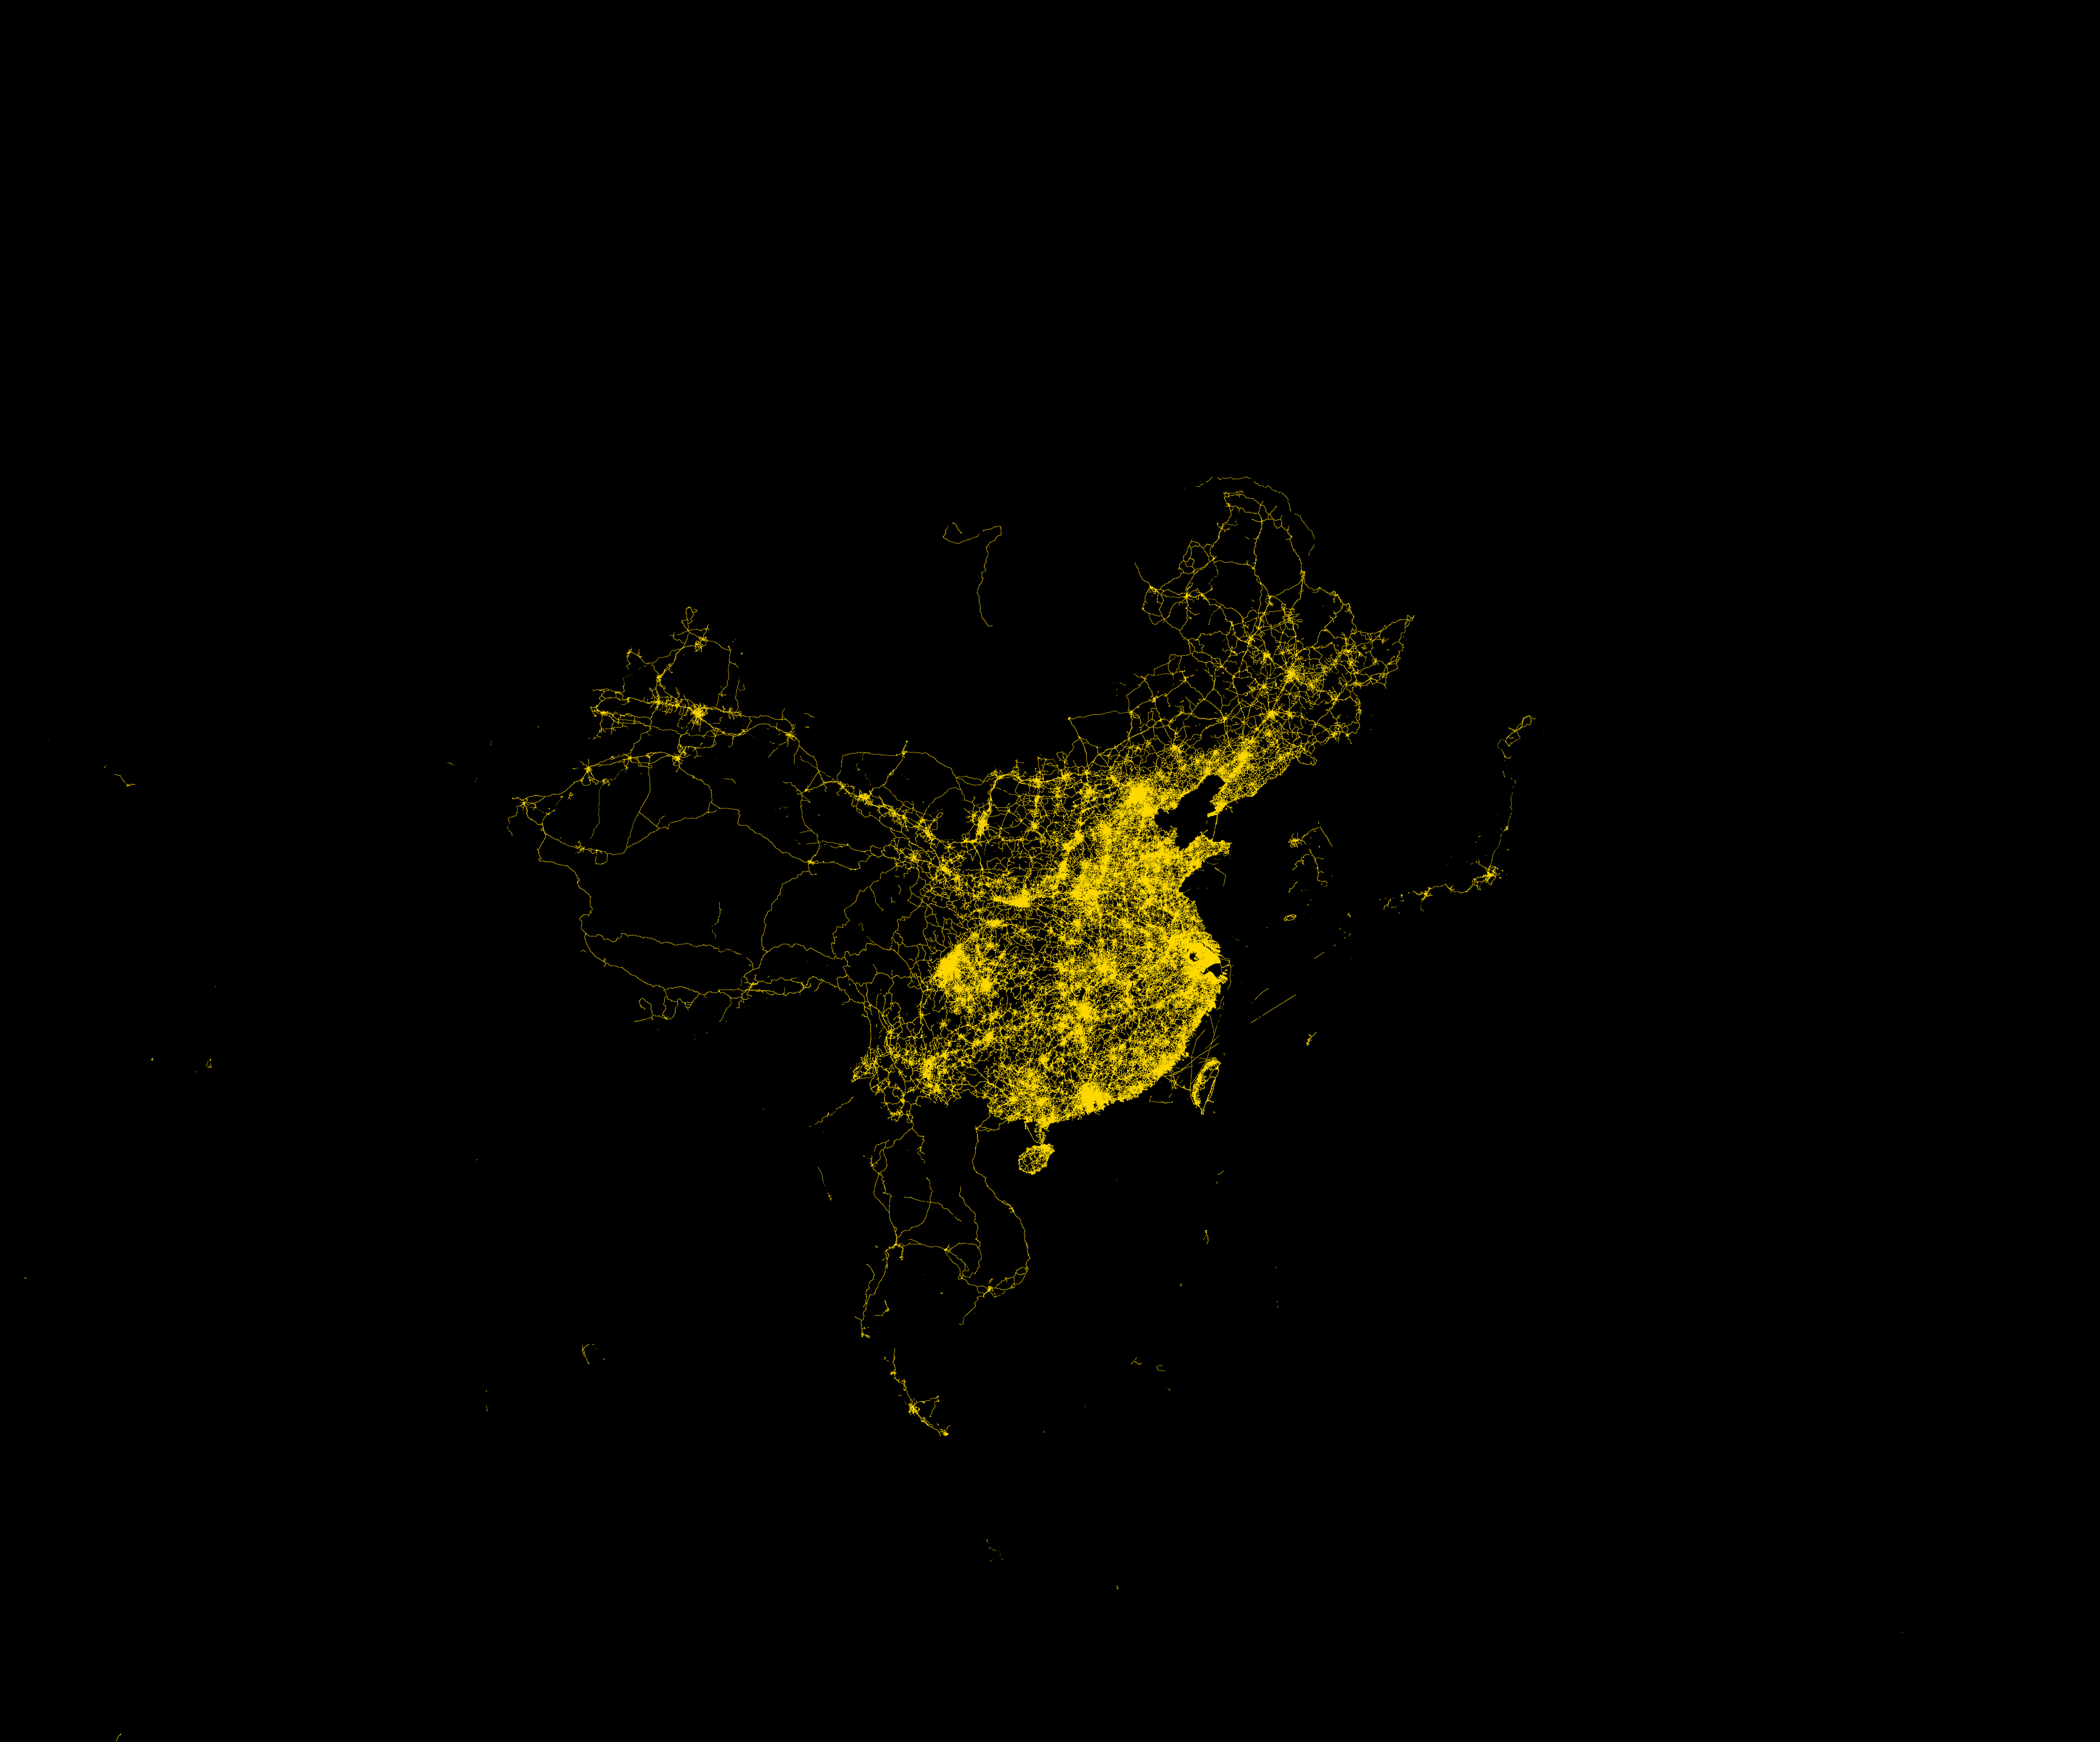
QiCYCLE APPs
Professional Cycling & Services applications
1,348,622 USERS
QiCYCLE Community
98,384,326 km
Cycling Mileage
Cycling Tool
Community
E-Commerce
Services
421 Stations
Services & Retails

Slide 10
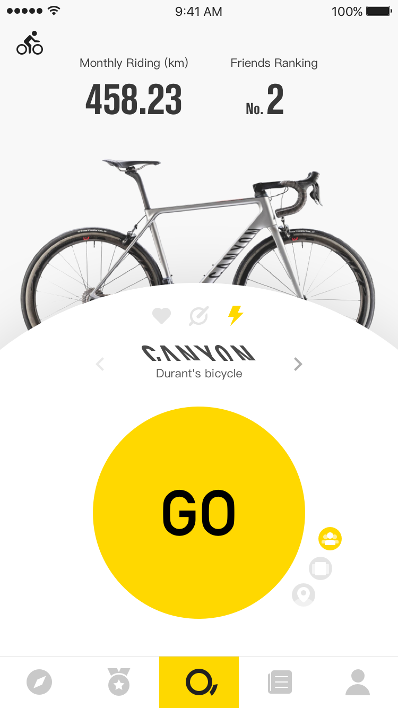
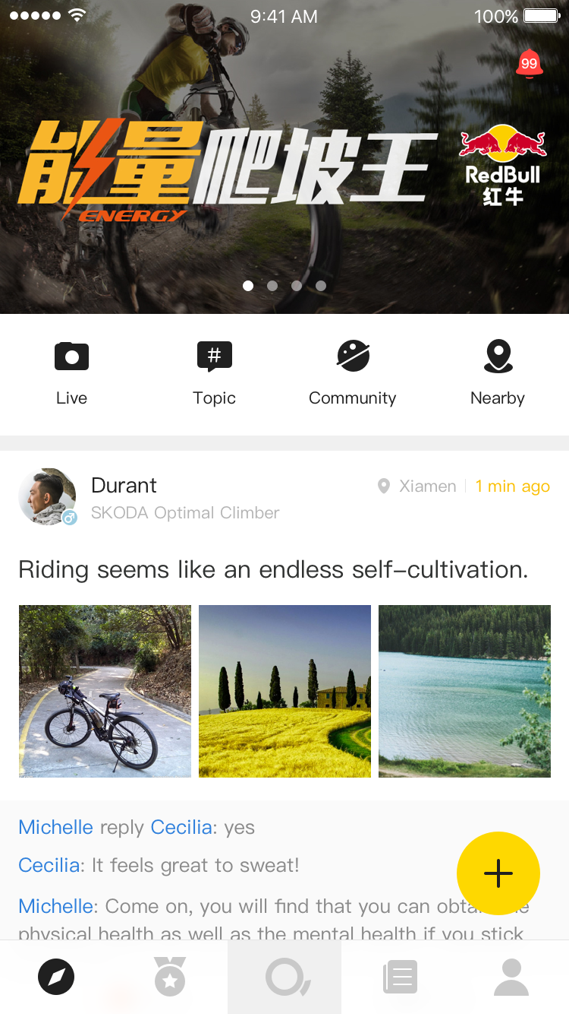
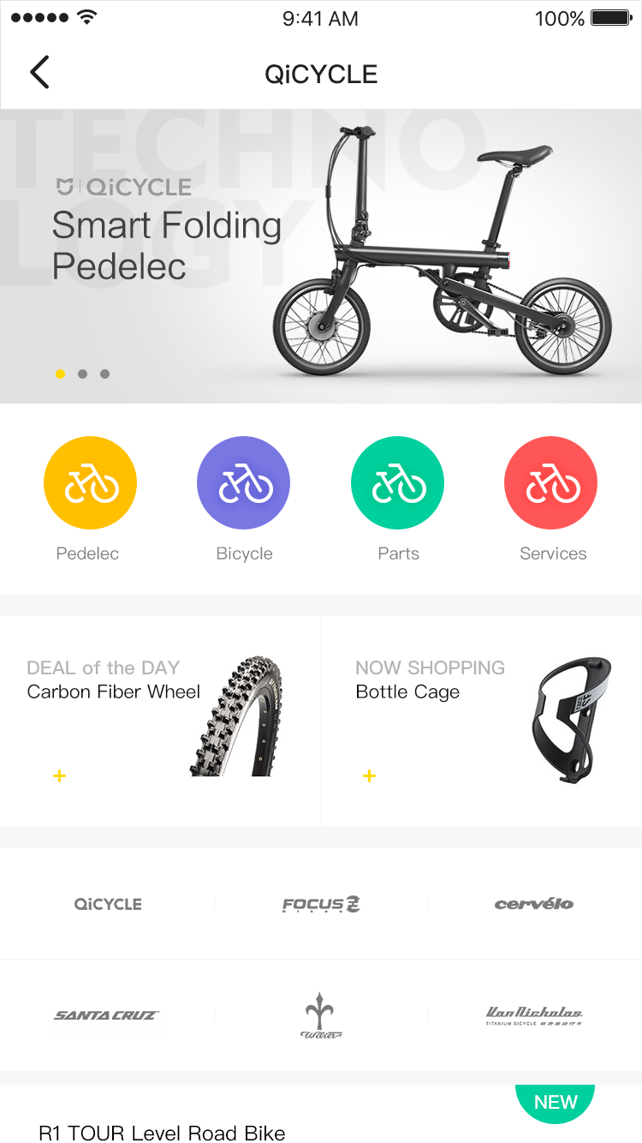
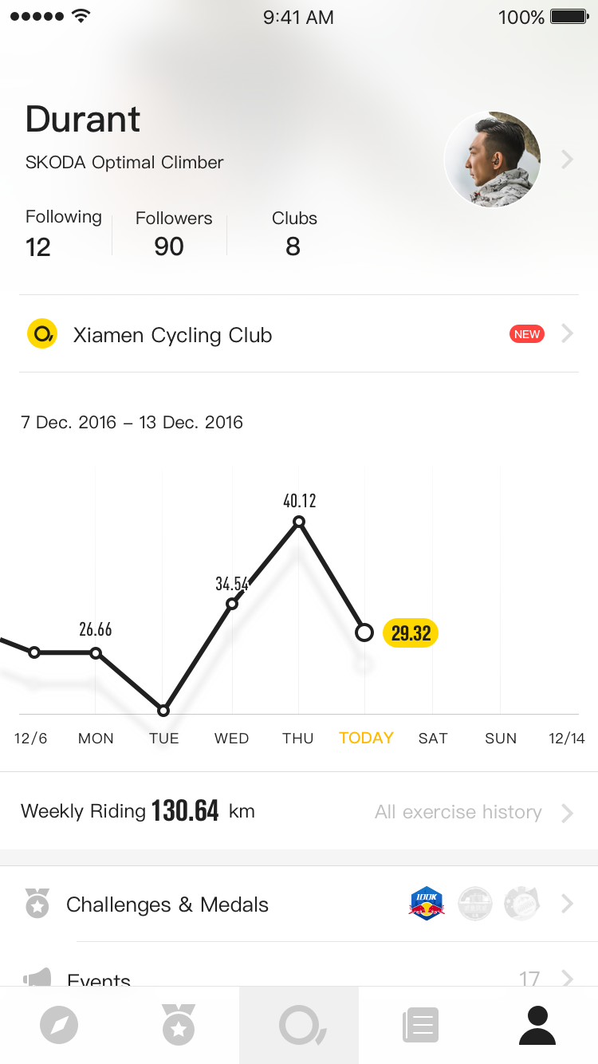
International QiCYCLE APP
Jan 2017 release
iOS & Android
Cycling Tool
Community
E-Commerce
User History

Slide 11
QiCYCLE Product in 2017
Provide more competitive product for Xiaomi Channel.
Provide QiCYCLE China & Global Channel product.
Products are IoT available, user behavior analyze.
8 products covered every price range, satisfied consumers’ needs.

Slide 12
Co-Branding in 2017
QiCYCLE’s Co-Branding with PON Group in China.
The cooperation with best bicycle components suppliers.
Cooperation in “ branding, product, supplier chain, sales channel”.
Through cooperation to enrich QiCYCLE’s production line, to satisfied China’s market requirement.
One of the biggest bicycle group.
PON‘s Brand：

Slide 14
The Cooperation Around the World
12 countries agents’ cooperation.
Agents covered main bicycle consumer market.
Overseas sales, meanwhile QiCYCLE’s intelligence software service.

Slide 15
www.Qi.bike

